Slide 1


Slide 2

CONTENT
GENERAL GUIDELINES
STUDENTS
PBL
RESEARCH AND RANKING
BUSINESS COLLABORATION
STRATEGY 2016-21

Slide 3

Introduction, change random picture

Slide 4

AAU – KNOWLEDGE FOR THE WORLD
All degree programmes and research activities at Aalborg University are problem and project-based and have an interdisciplinary focus.
Through strong interplay between staff and students and intense collaboration with public and private sectors, we offer degree programmes with a real-world approach and provide world-class research.
This results in new insights, new solutions to societal challenges and knowledge that changes the world.

Slide 5
AAU – KNOWLEDGE FOR THE WORLD
All degree programmes and research activities at Aalborg University are problem and project-based and have an interdisciplinary focus.
Through strong interplay between staff and students and intense collaboration with public and private sectors, we offer degree programmes with a real-world approach and provide world-class research.
This results in new insights, new solutions to societal challenges and knowledge that changes the world.

Slide 6
Time Management Table
Name | Time holding breath under water | Time without criticizing work | Time used for eating
Nicolai | 29:10 | 29:10 | 20:00
Thassilo | 10:02 | 10:02 | 20:00
Aitor | 00:17 | 00:17 | 20:00
Nicolas | 19:57 | 00:00 | ∞

Slide 7
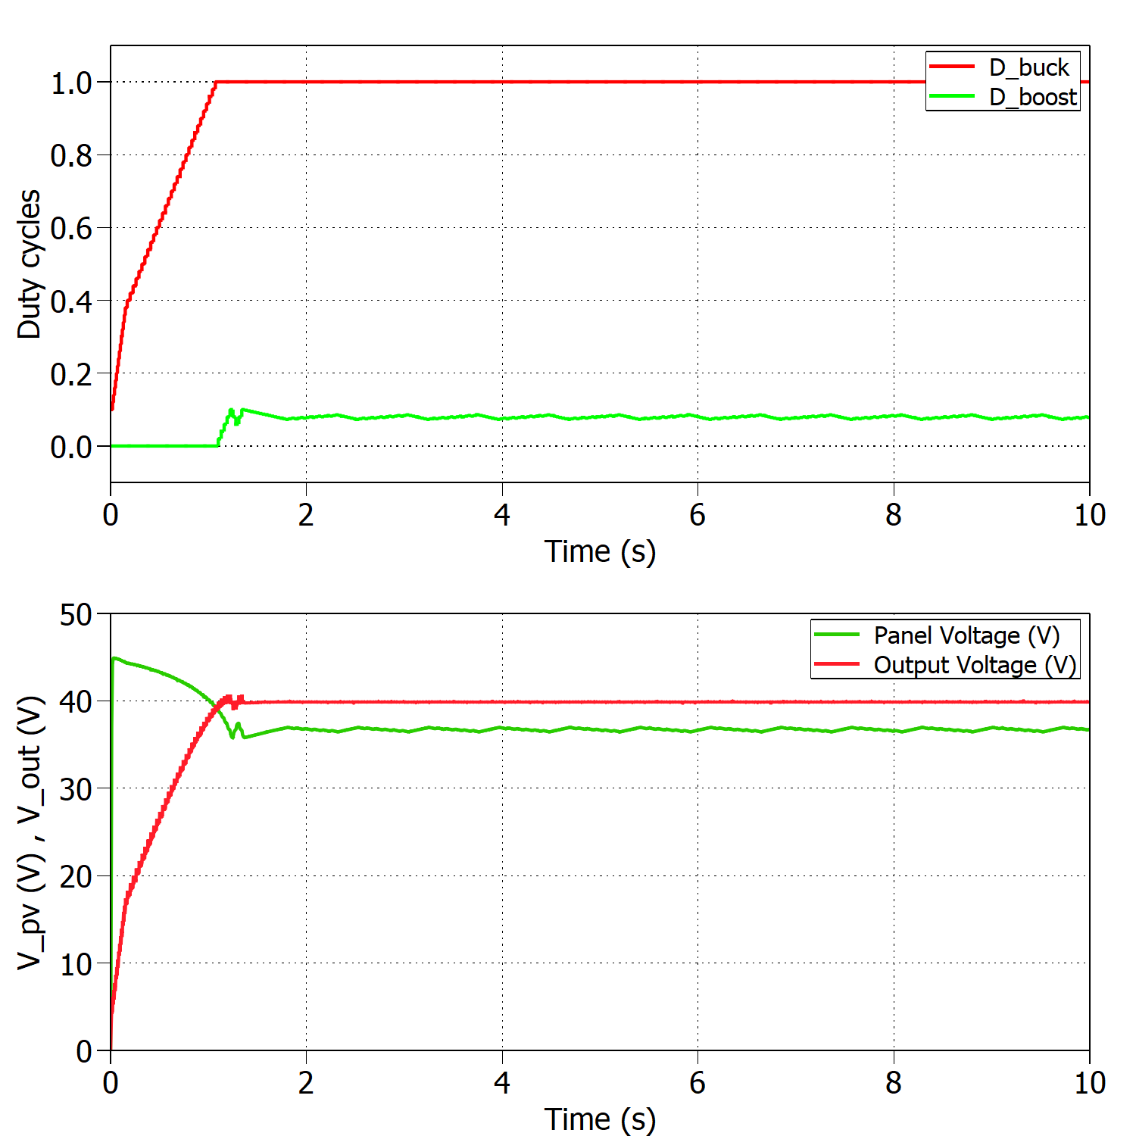
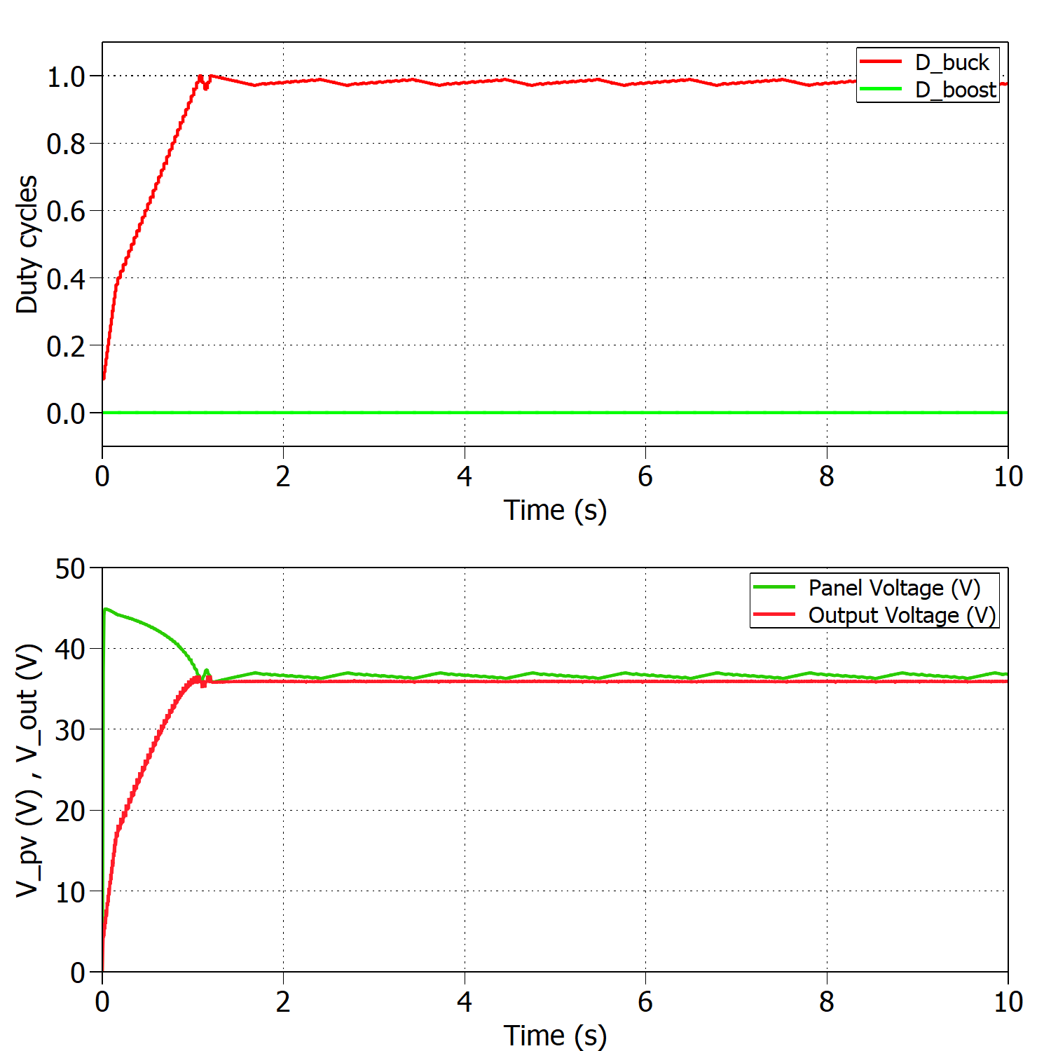
Time Management Table
Add a nice looking caption if you have multiple figures at one slide
And make sure that they are better aligned than this…

Slide 8
MPPT algorithm

Slide 9
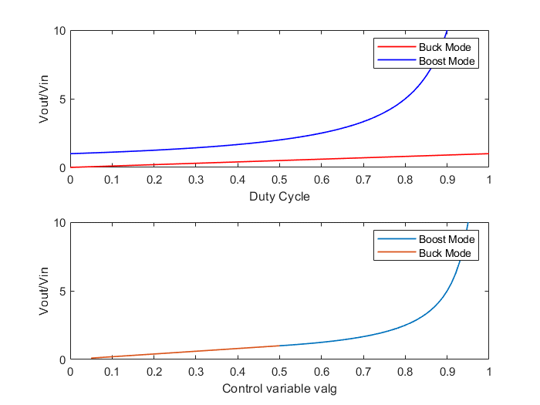

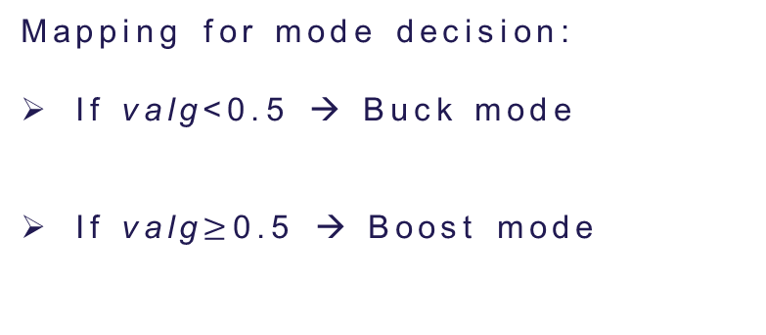
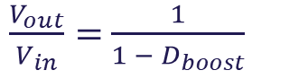
Initial MPPT implementation
$$\frac{V_{out}}{V_{in}}=D_{buck}$$
$\frac{V_{out}}{V_{in}}=$ $\frac{1}{1 − D_{boost}}$
Mapping for mode decision:
If valg<0.5 → Buck mode
If valg$≥$0.5 → Boost mode
Top figure: Conversion ratio for buck and boost modes.
Bottom figure: Mapping of the control variable valg for mode decision.
Incrementing valg means decreasing PV voltage!

Slide 10
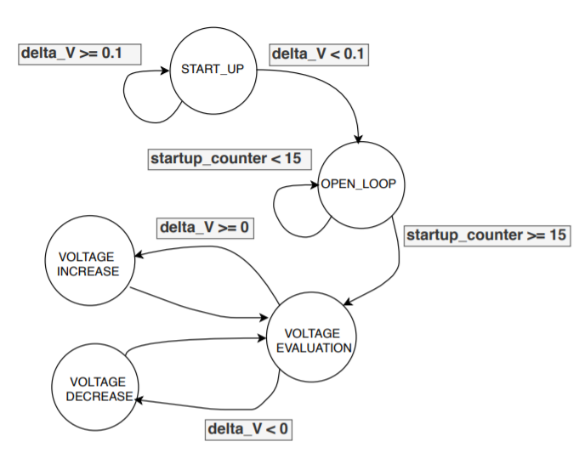
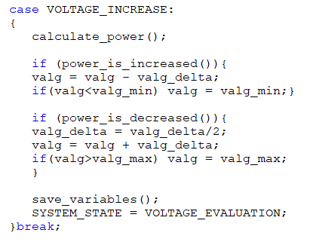
Initial MPPT implementation
When crossing the MPP the control variable is reduced to half of its value iteratively!
Problems:
“If/else” structure difficult to find errors
Variable step required more complex code
Finite state machine for P&O algorithm

Slide 11
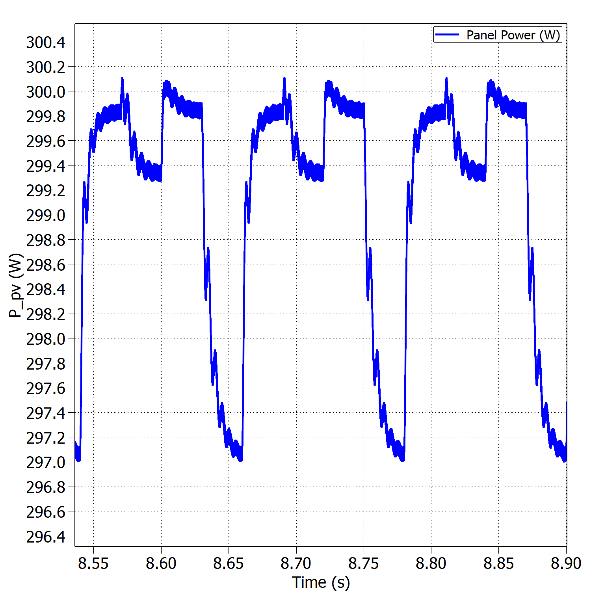
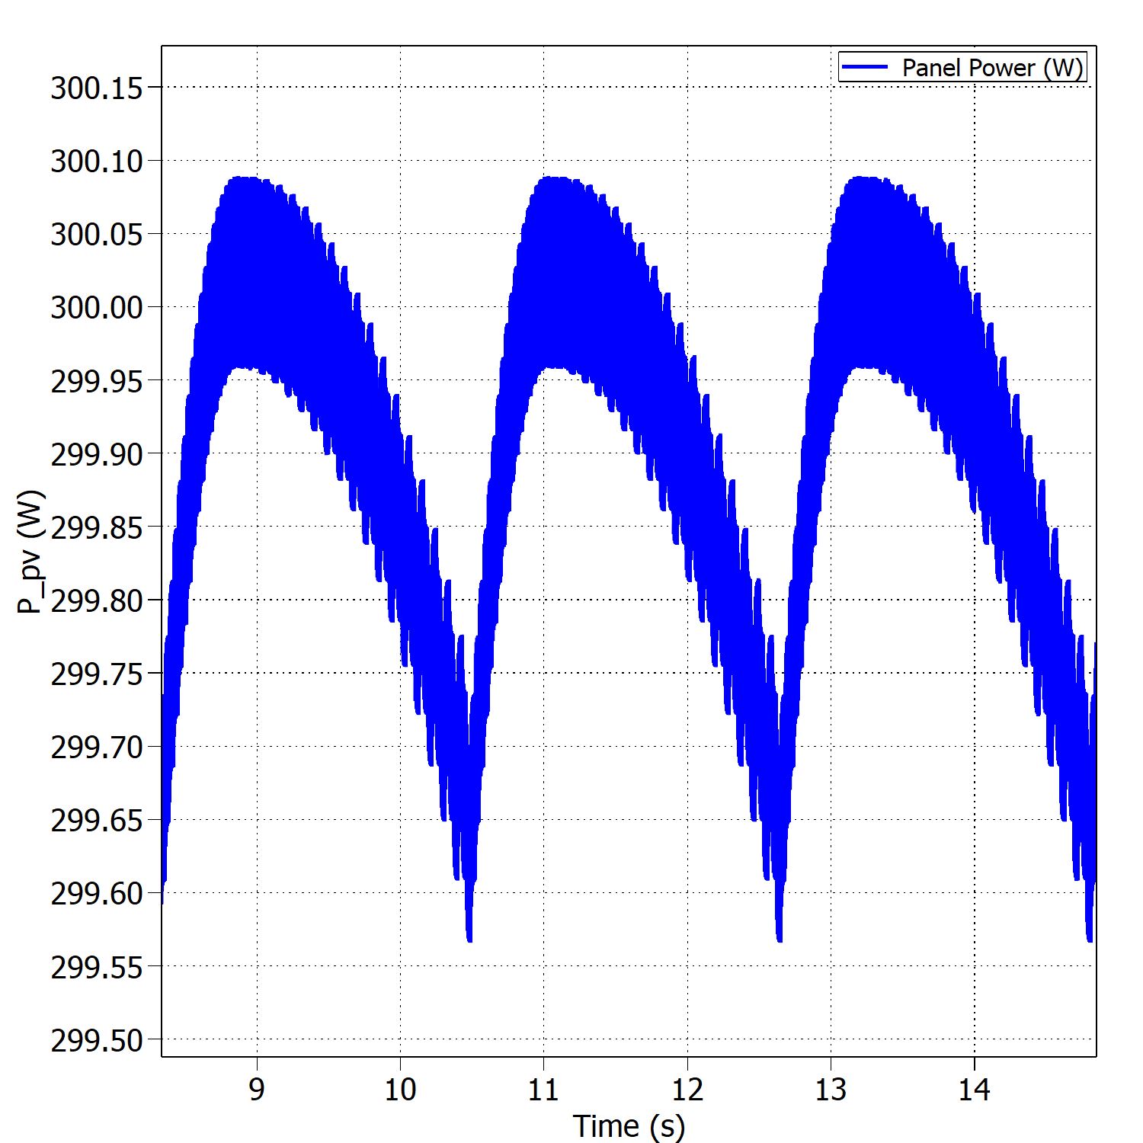


Fixed vs variable perturb step – Buck Mode
Oscillations around the MPP with fixed perturb step under STC.
Oscillations around the MPP with variable perturb step under STC.
$$η_{MPPT}=99.38\%$$
$$η_{MPPT}=99.96\%$$

Slide 12
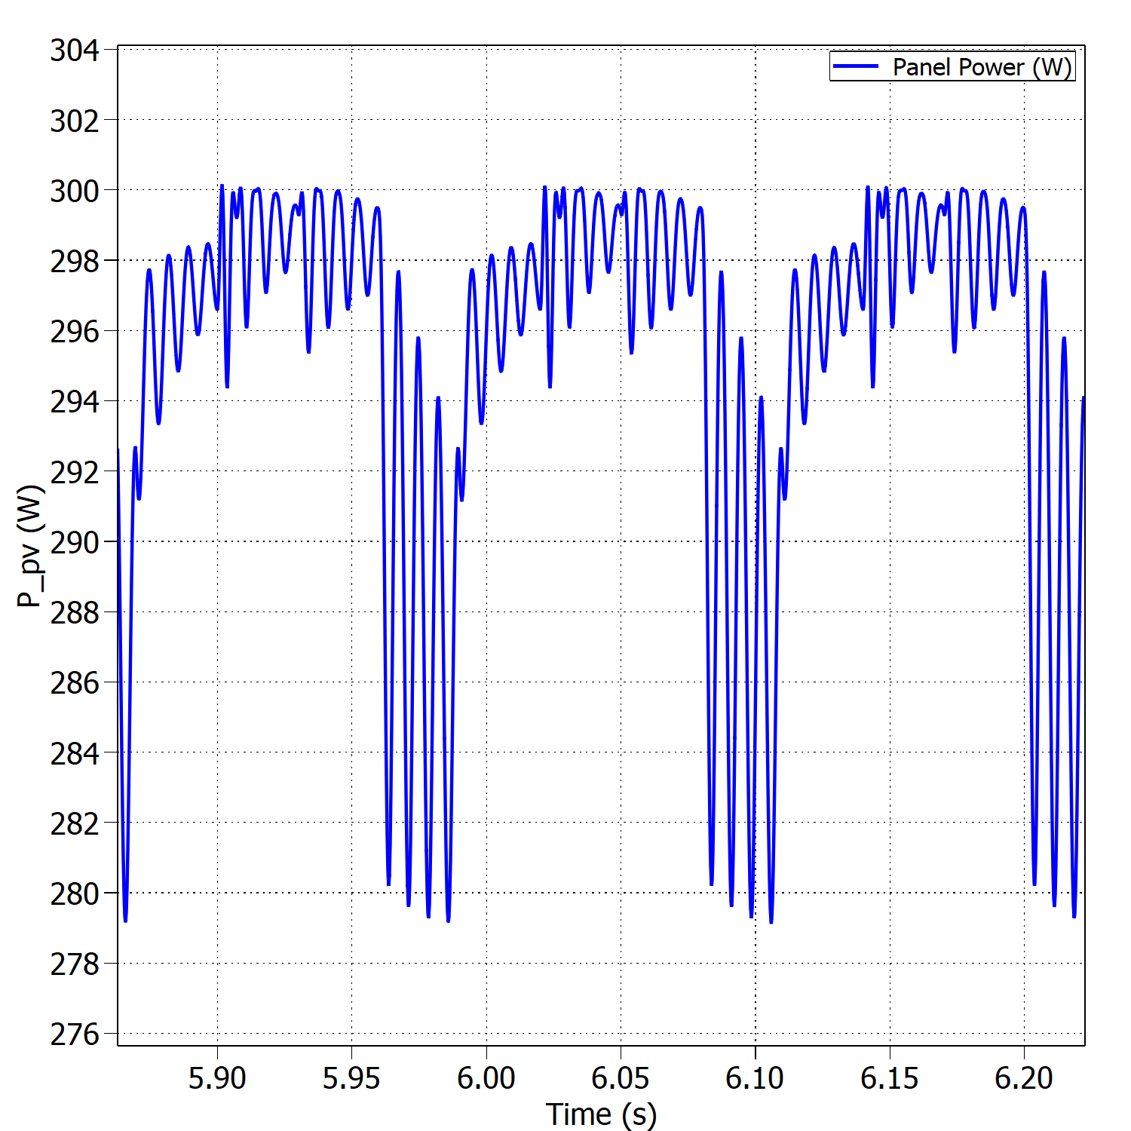
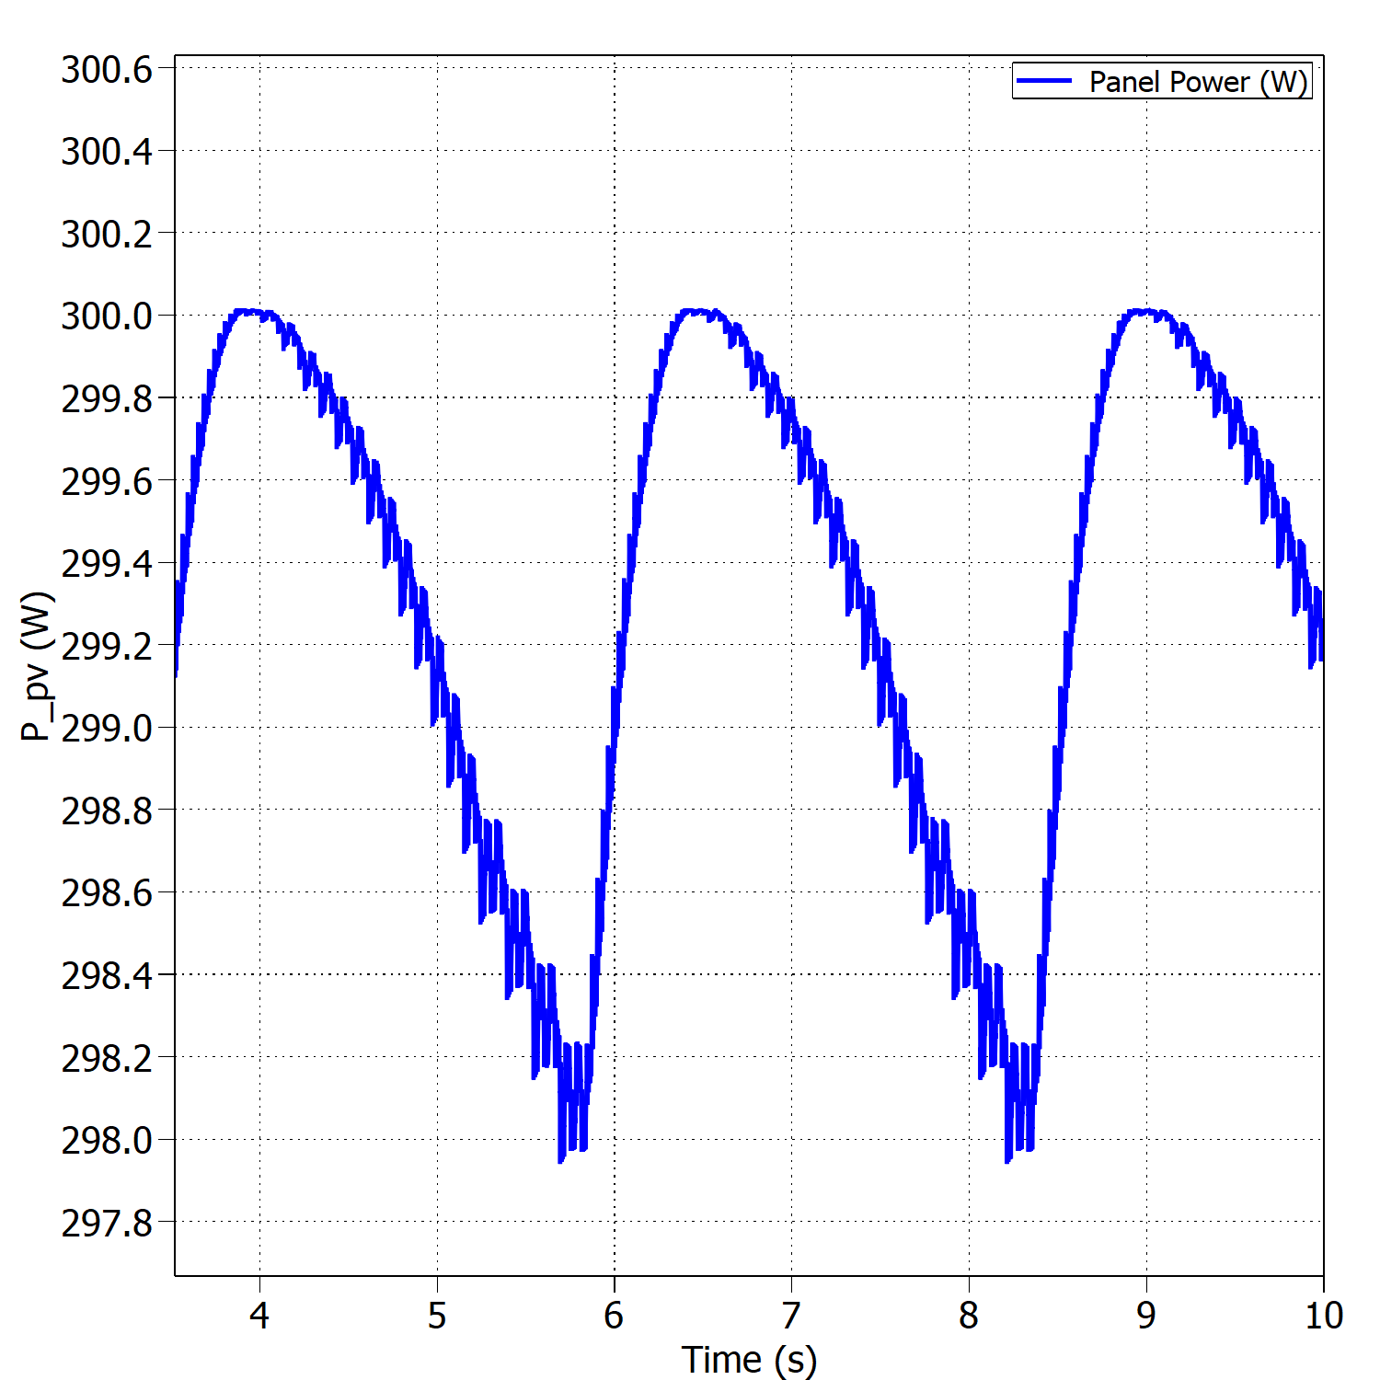


Fixed vs variable perturb step – Boost Mode
Oscillations around the MPP with fixed perturb step under STC.
Oscillations around the MPP with variable perturb step under STC.
$$η_{MPPT}=96.40\%$$
$$η_{MPPT}=99.82\%$$

Slide 13
Test Results

Slide 14
Components individually soldered and tested
Open-loop test for hardware validation
Model of the PV panel
Standard test conditions
Boundary between modes of operation
Sudden changes in environmental conditions
Converter’s efficiency

Slide 15
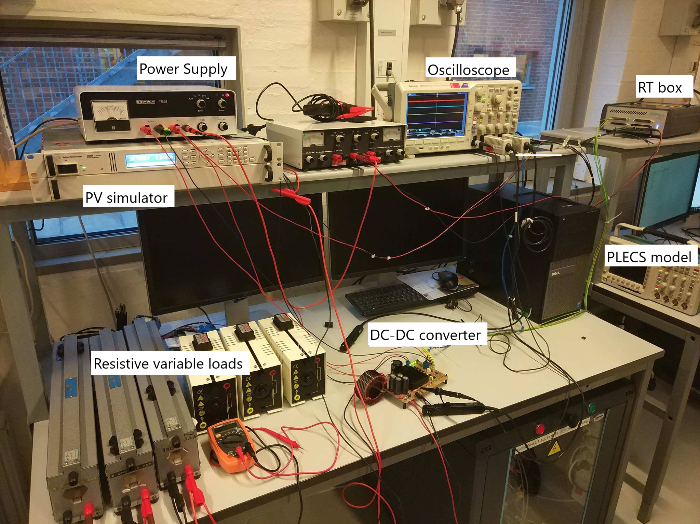
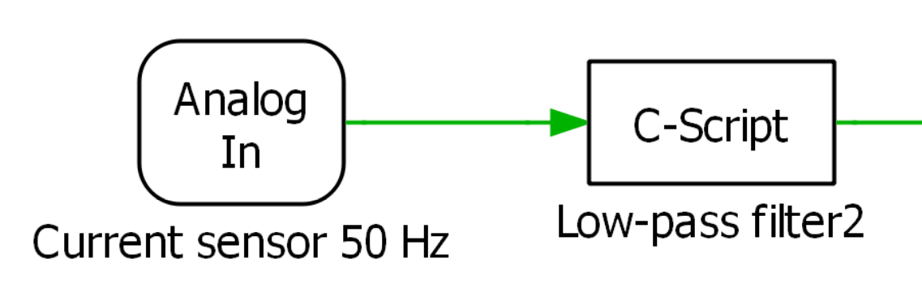
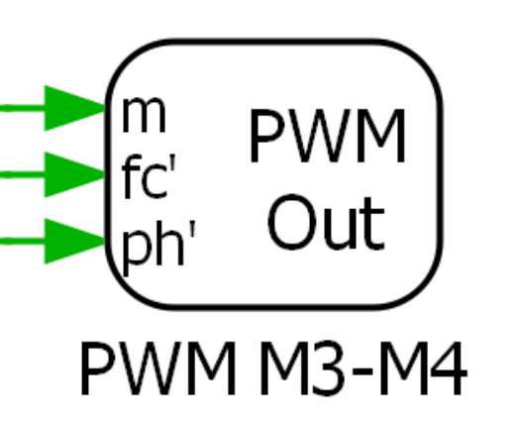
Test setup

Slide 16
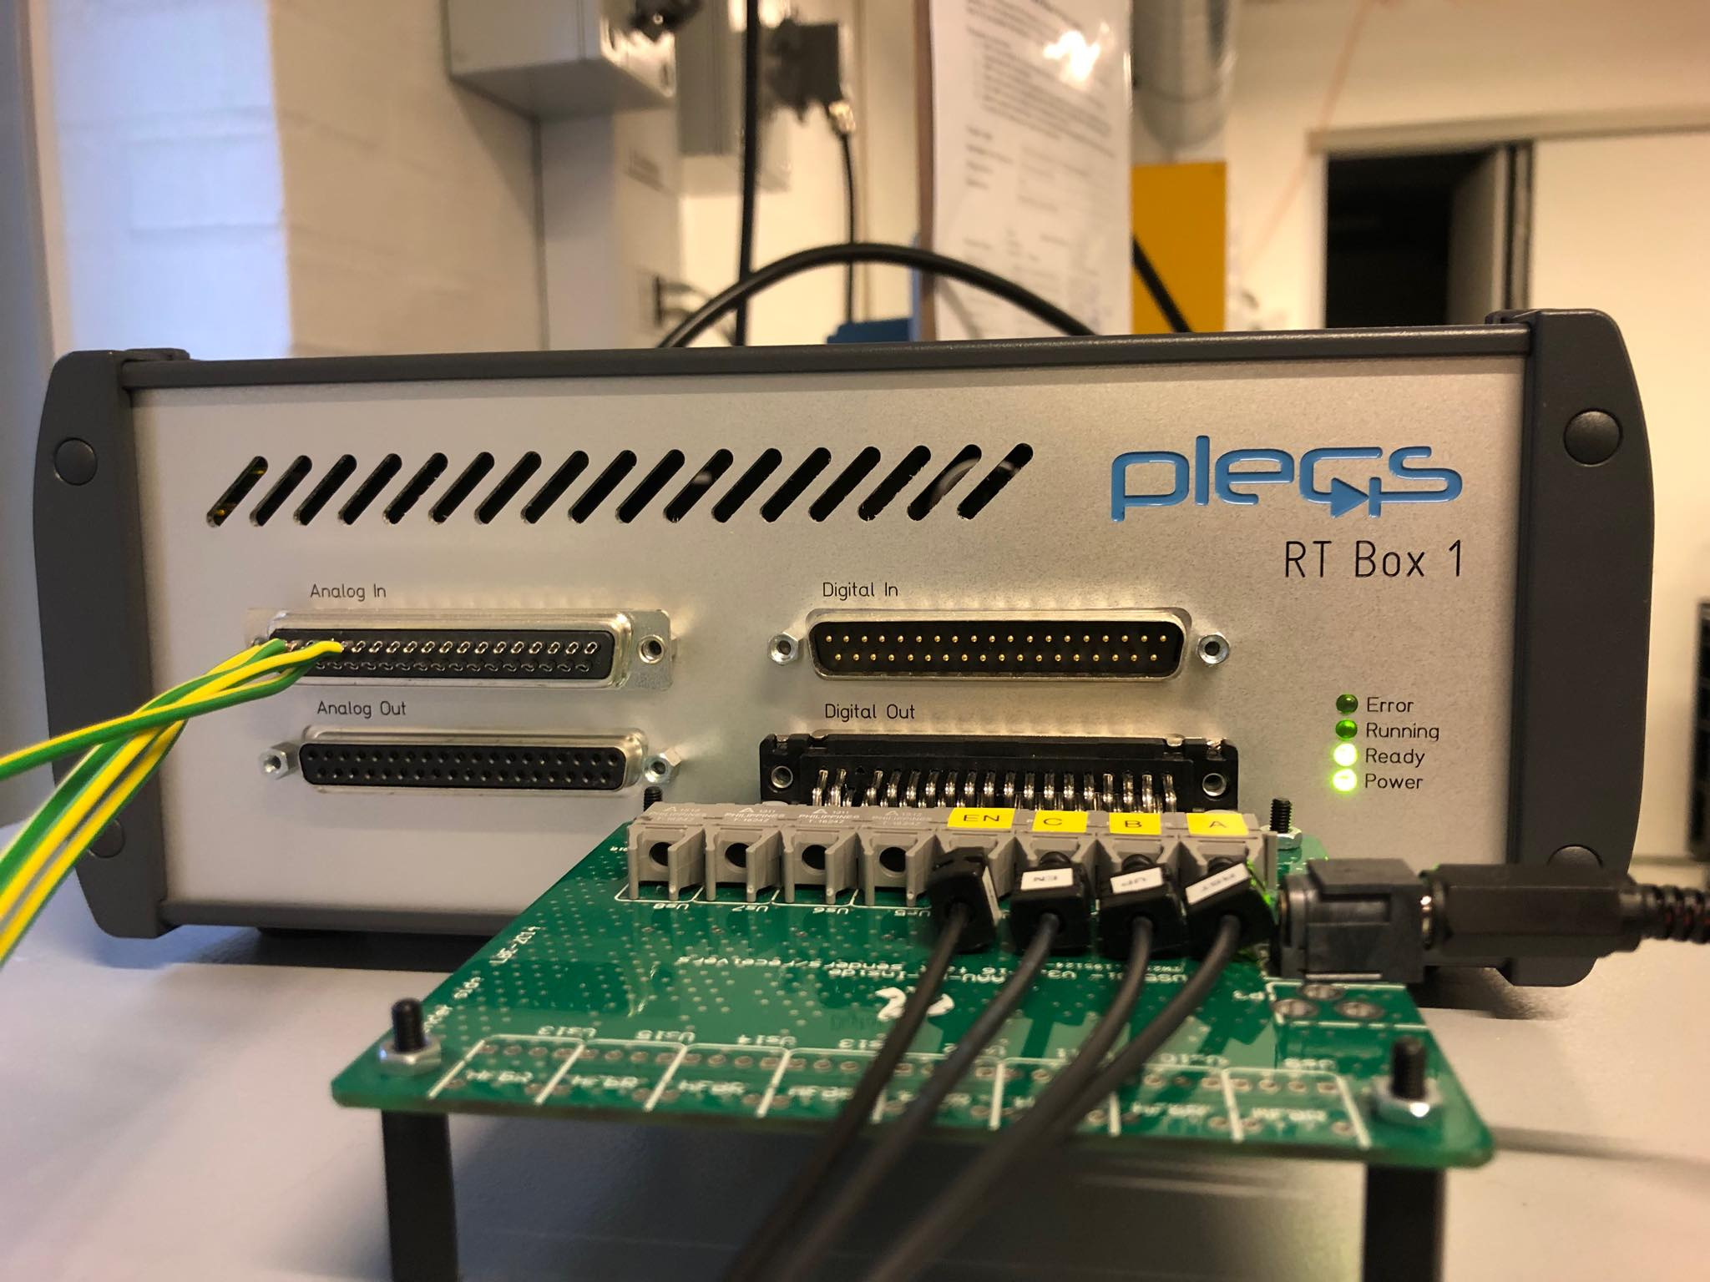
Test setup

Slide 17
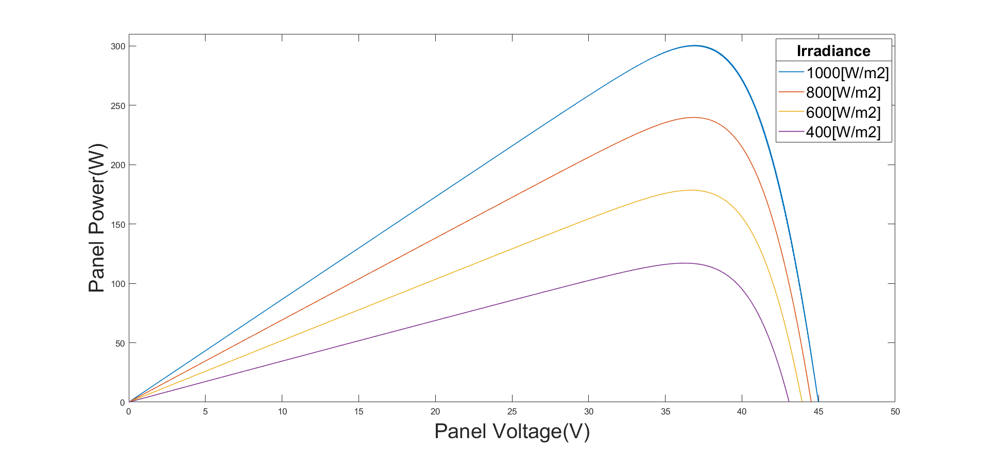
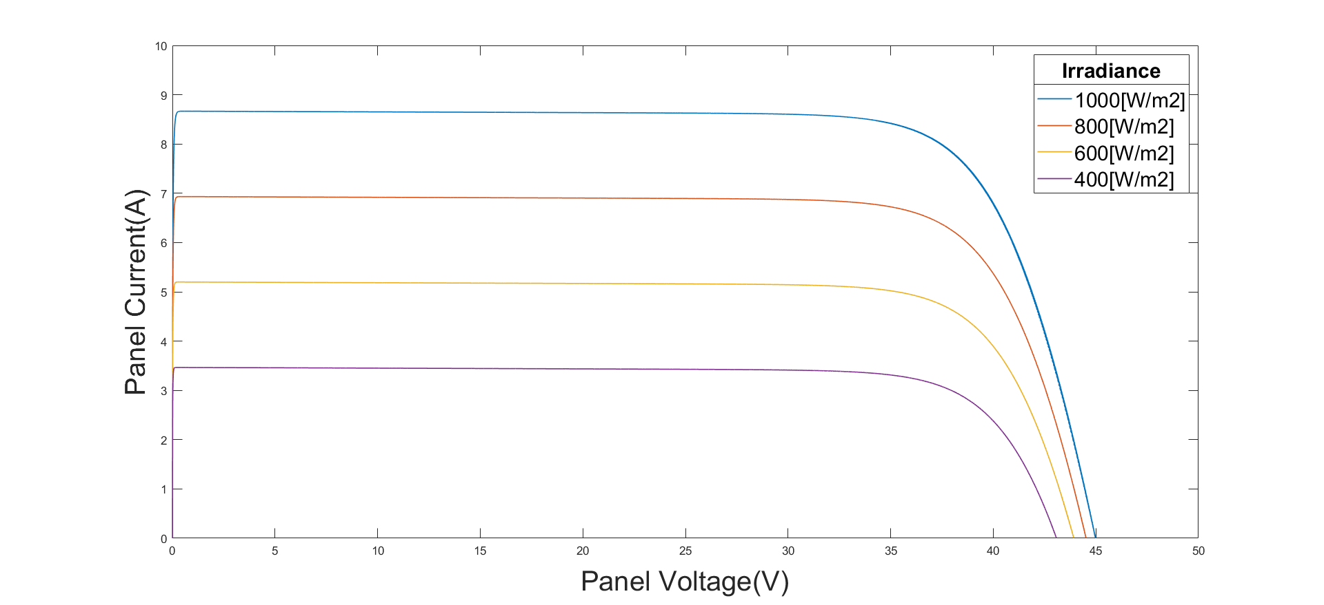
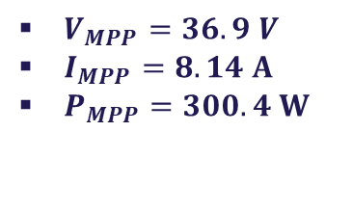
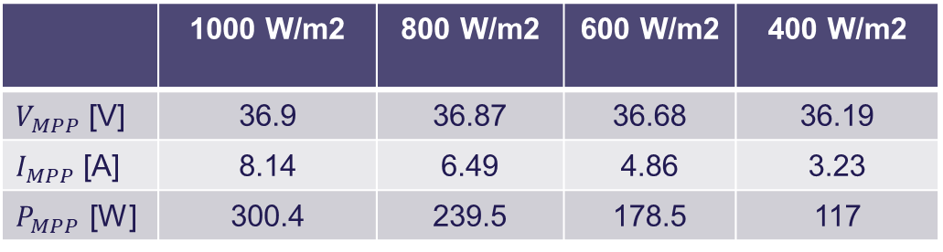
PV panel curves
$V_{MPP}=36.9 V$
$I_{MPP}=8.14 A$
$P_{MPP}=300.4 W$
Irradiance effect:
PV module datasheet (STC)
P-V curves for T=25ºC and varying irradiance.
I-V curves for T=25ºC and varying irradiance.
 | 1000 W/m2 | 800 W/m2 | 600 W/m2 | 400 W/m2
$V_{MPP}$ [V] | 36.9 | 36.87 | 36.68 | 36.19
$I_{MPP}$ [A] | 8.14 | 6.49 | 4.86 | 3.23
$P_{MPP}$ [W] | 300.4 | 239.5 | 178.5 | 117

Slide 18
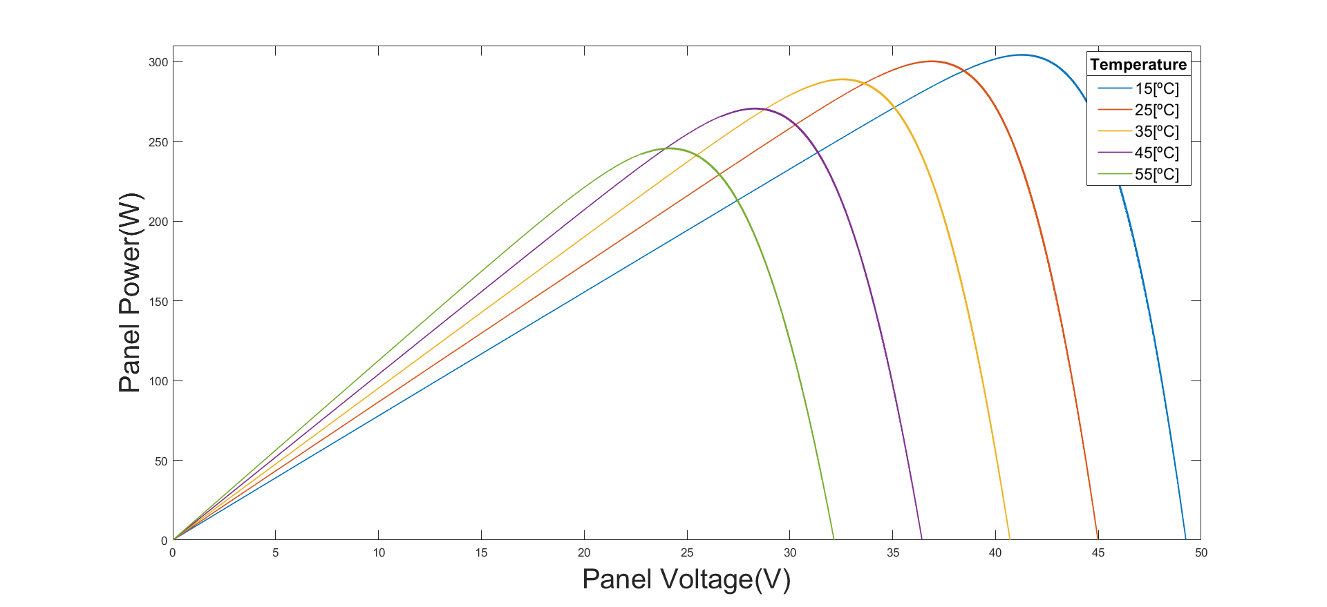
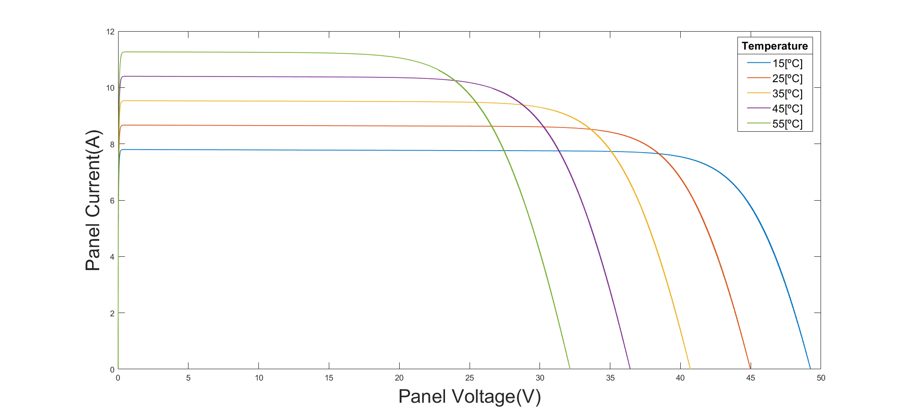
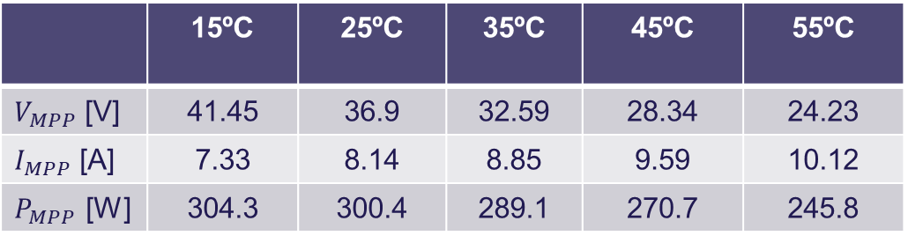
PV panel curves
Temperature effect:
P-V curves for 1000 W/m2 and varying temperature.
I-V curves for 1000 W/m2 and varying temperature.
 | 15ºC | 25ºC | 35ºC | 45ºC | 55ºC
$V_{MPP}$ [V] | 41.45 | 36.9 | 32.59 | 28.34 | 24.23
$I_{MPP}$ [A] | 7.33 | 8.14 | 8.85 | 9.59 | 10.12
$P_{MPP}$ [W] | 304.3 | 300.4 | 289.1 | 270.7 | 245.8

Slide 19
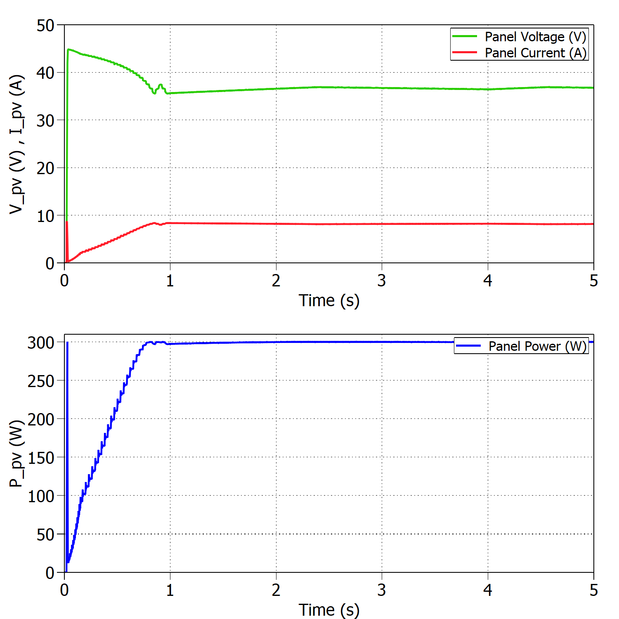
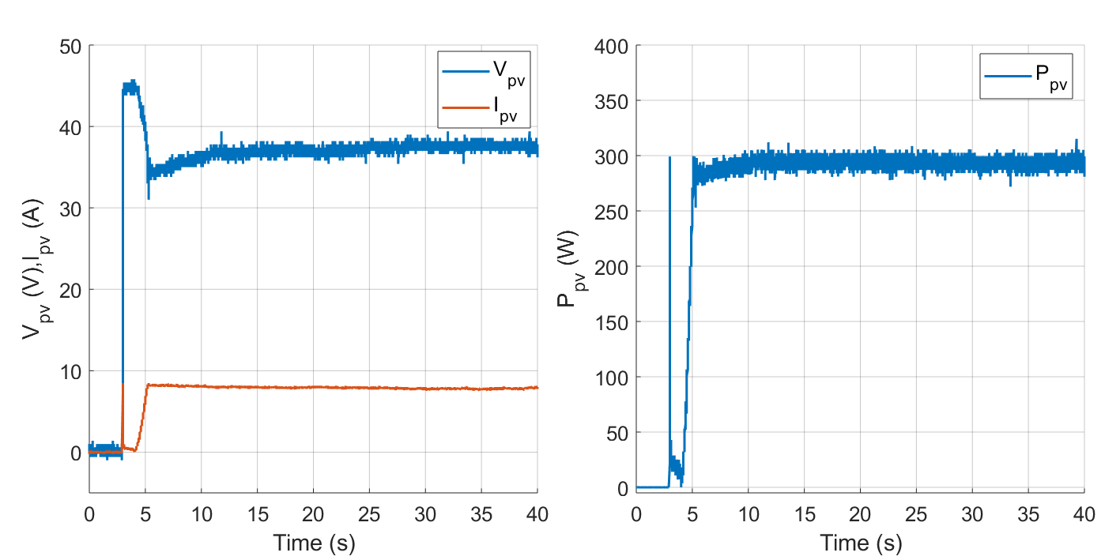
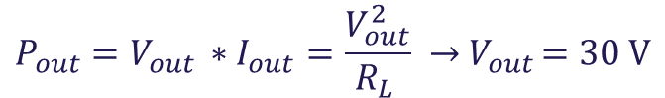


Standard Test Conditions (STC)
Buck mode:
Experimental results under STC with $R_{L}=3 Ω$.
$$P_{out}=V_{out }∗I_{out}=\frac{V_{out}^{2}}{R_{L }} →{ V}_{out }=30 V$$
$$η_{MPPTsim}=99.96\%$$
$$η_{MPPTexp}=97.72\%$$
Simulated results under STC with $R_{L}=3 Ω$.

Slide 20
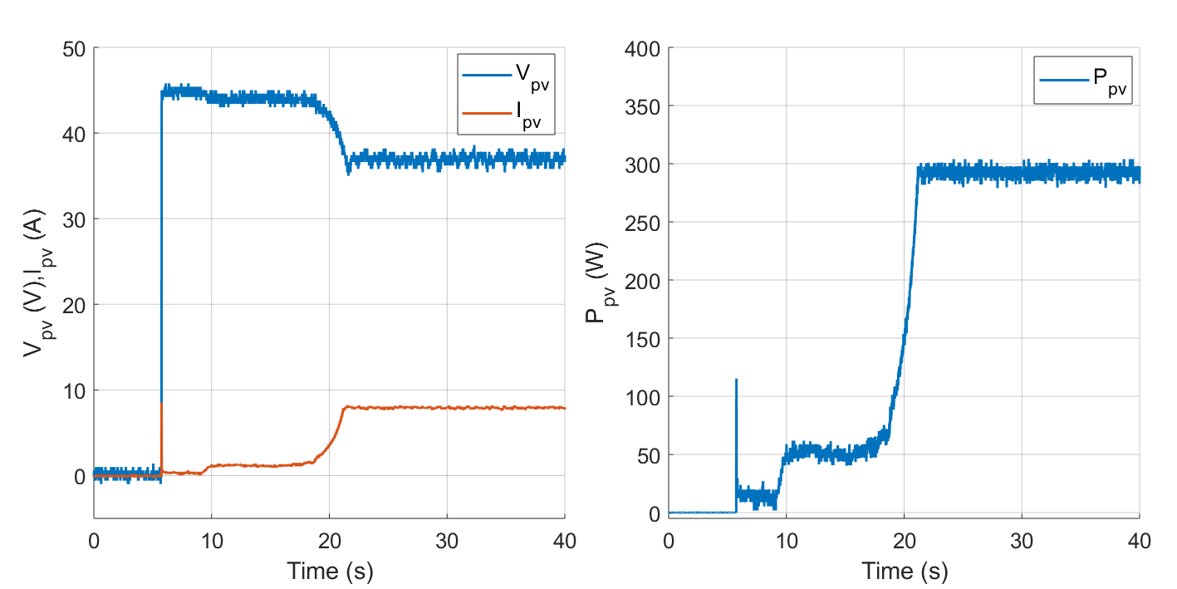
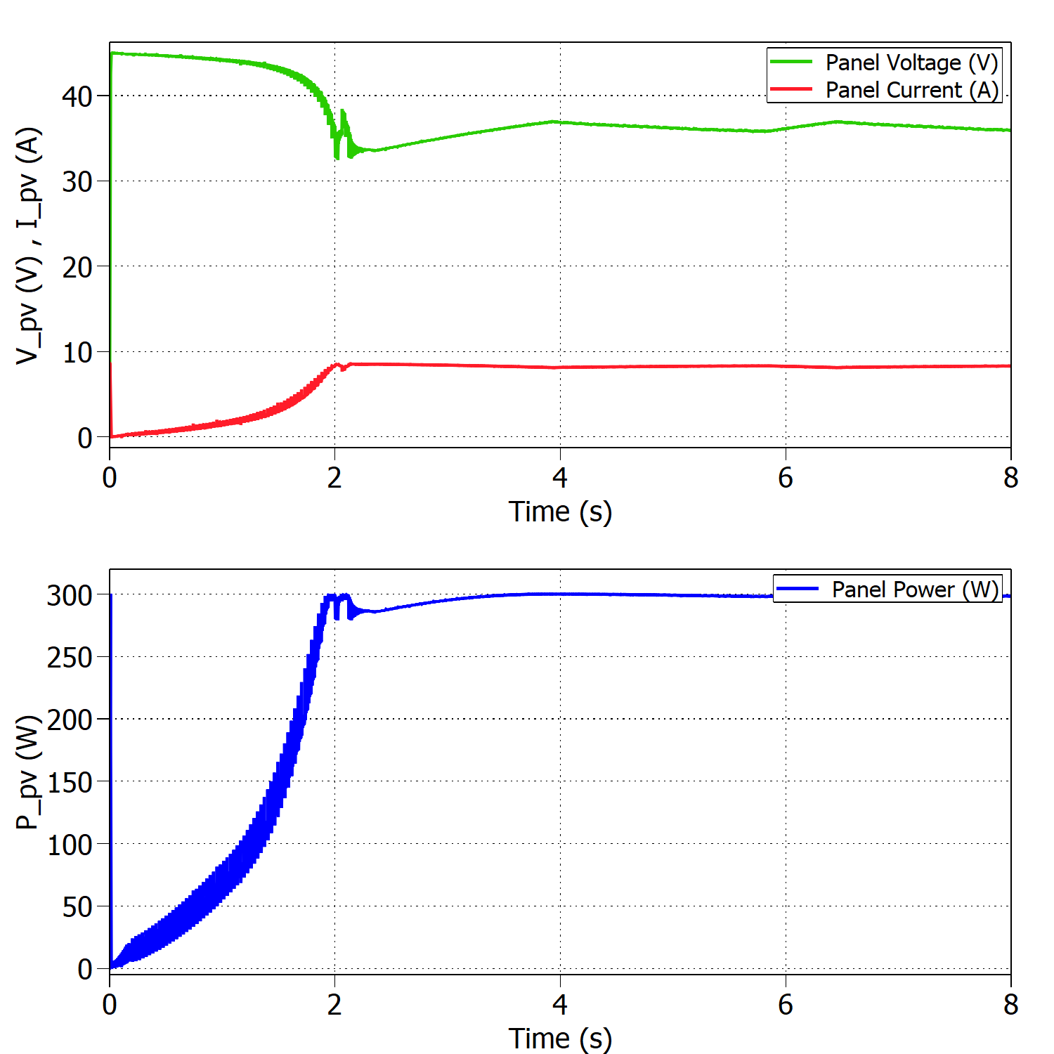
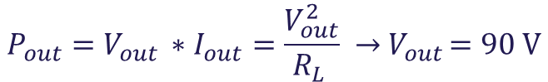


Standard Test Conditions (STC)
Boost mode:
Experimental results under STC with $R_{L}=27 Ω$.
$$P_{out}=V_{out }∗I_{out}=\frac{V_{out}^{2}}{R_{L }} →{ V}_{out }=90 V$$
Simulated results under STC with $R_{L}=27 Ω$.
$$η_{MPPTsim}=99.82\%$$
$$η_{MPPTexp}=97.32\%$$

Slide 21
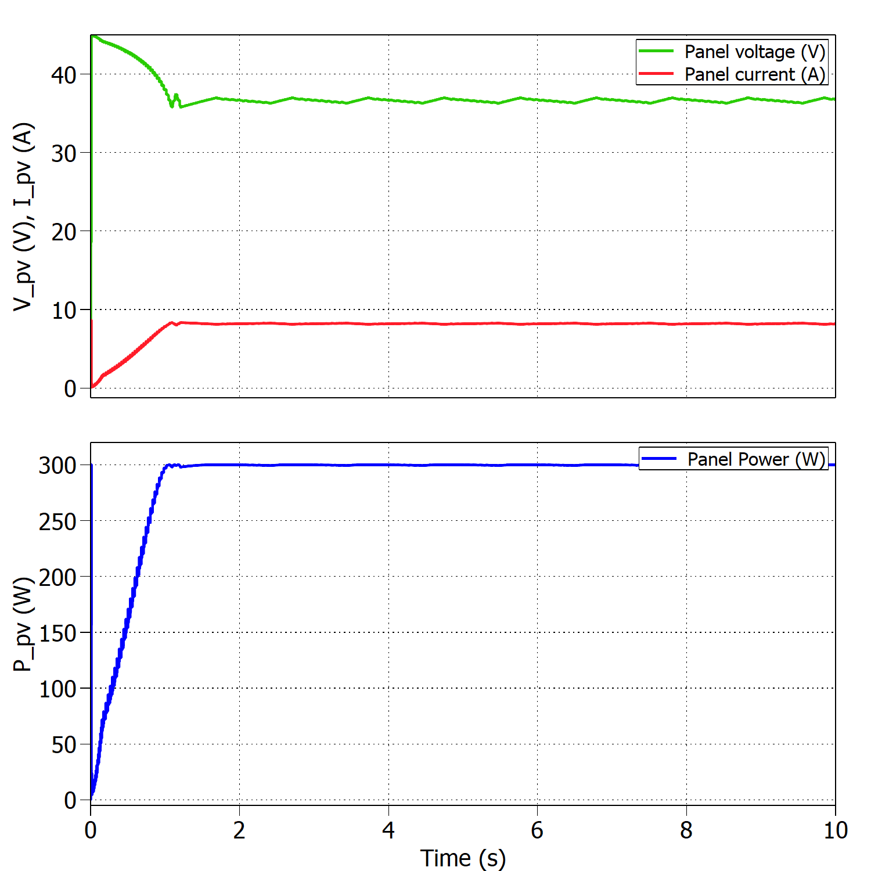



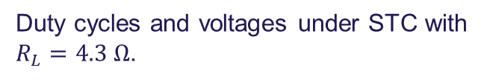
Boundary between modes of operation
Buck mode (10 PV panels):
$$R_{MPP}^{ }= \frac{V_{MPP}^{ }}{I_{MPP}^{ }} →R_{MPP}^{ }=4.53 Ω$$
9.75 panels →10 panels
If T>25ºC → Boost
$$η_{MPPT}=99.75\%$$
Panel’s voltage, current and power under STC with $R_{L}=4.3 Ω$.
Duty cycles and voltages under STC with $R_{L}=4.3 Ω$.

Slide 22
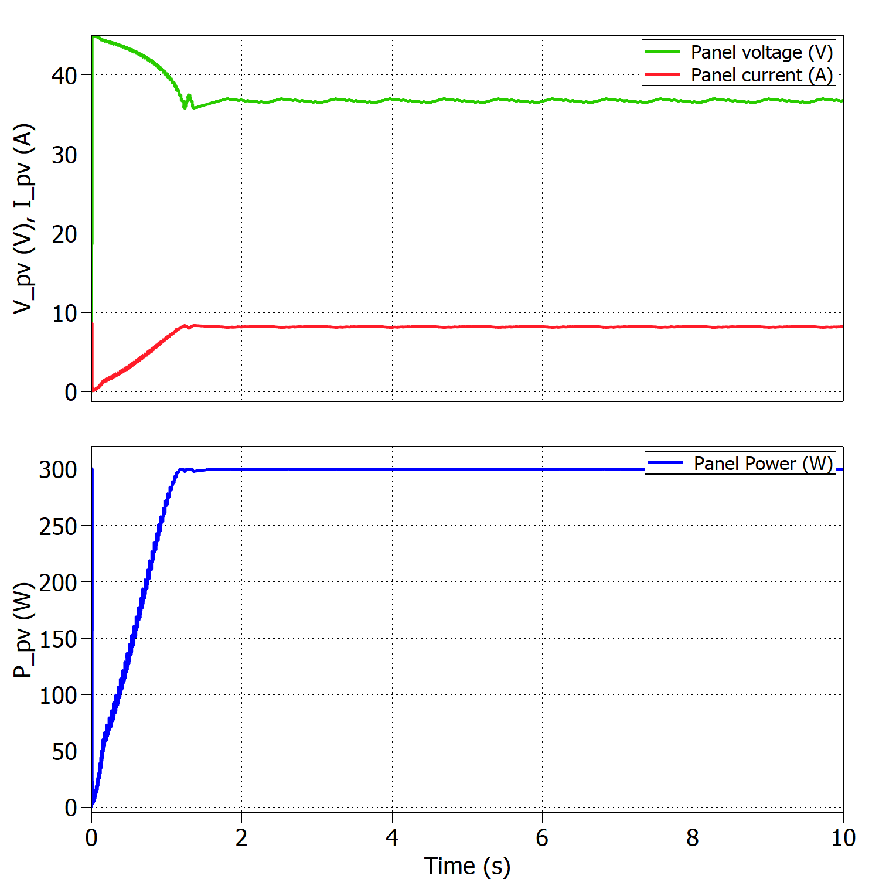



Boundary between modes of operation
Boost mode (9 PV panels):
$$R_{MPP}^{ }= \frac{V_{MPP}^{ }}{I_{MPP}^{ }} →R_{MPP}^{ }=4.53 Ω$$
9.75 panels →9 panels
If T<25ºC → Buck
$$η_{MPPT}=99.80\%$$
Panel’s voltage, current and power under STC with $R_{L}=5.3 Ω$.
Duty cycles and voltages under STC with $R_{L}=5.3 Ω$.

Slide 23
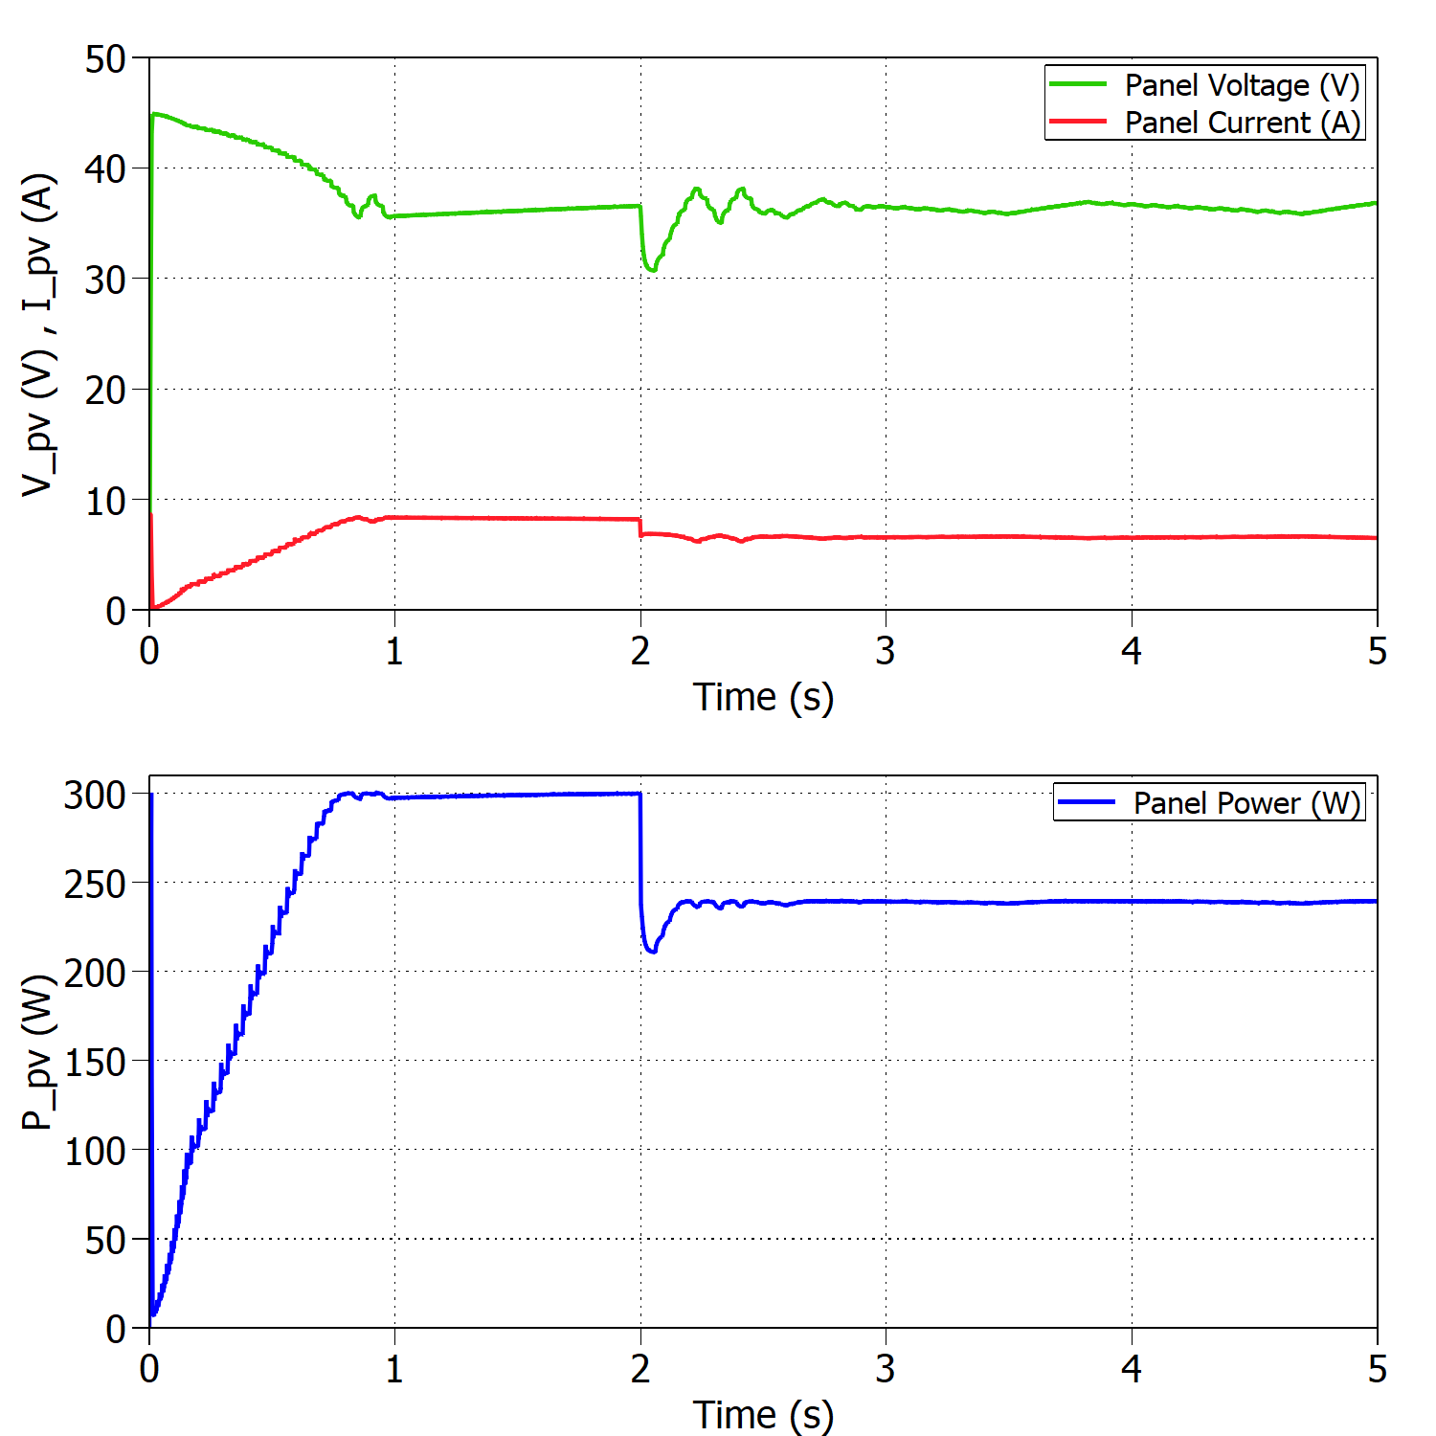
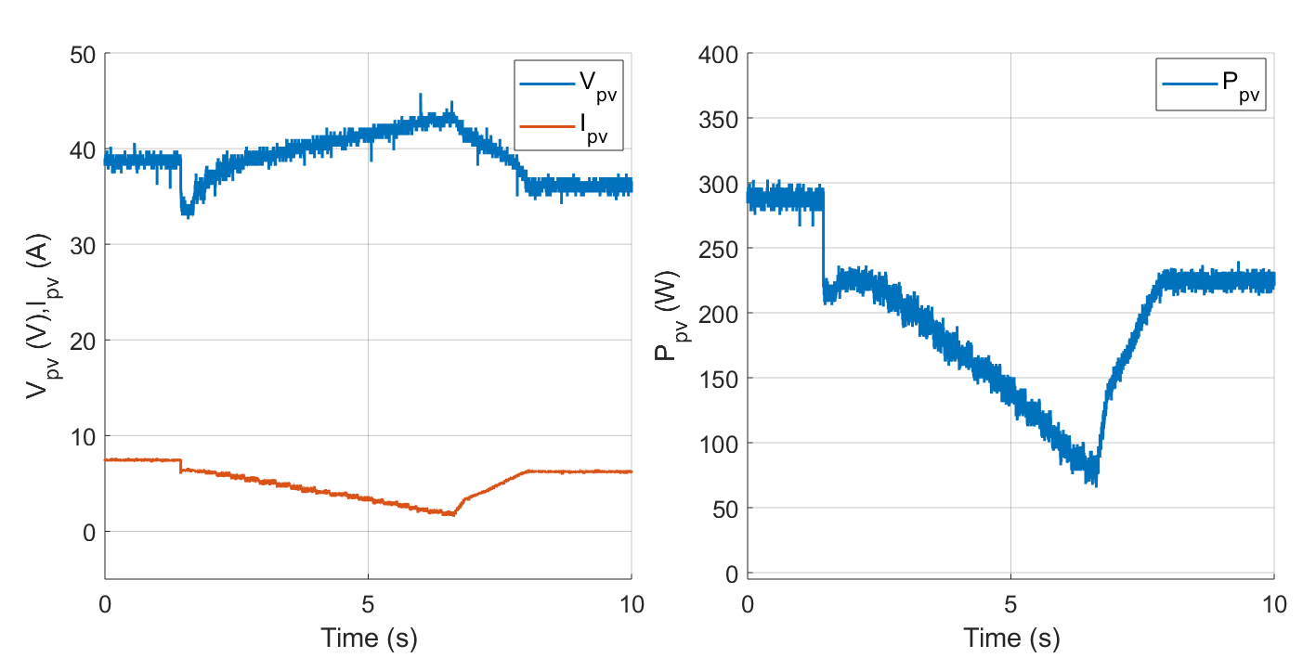



Sudden change in irradiance
Buck mode ${(R}_{L}=3 Ω)$:
Experimental results for 1000 - 800 W/m2 and constant temperature T=25ºC.
Simulated results for 1000 - 800 W/m2 and constant temperature T=25ºC.
$$η_{MPPTsim}=99.70\%$$
$$η_{MPPTexp}=93.78\%$$

Slide 24
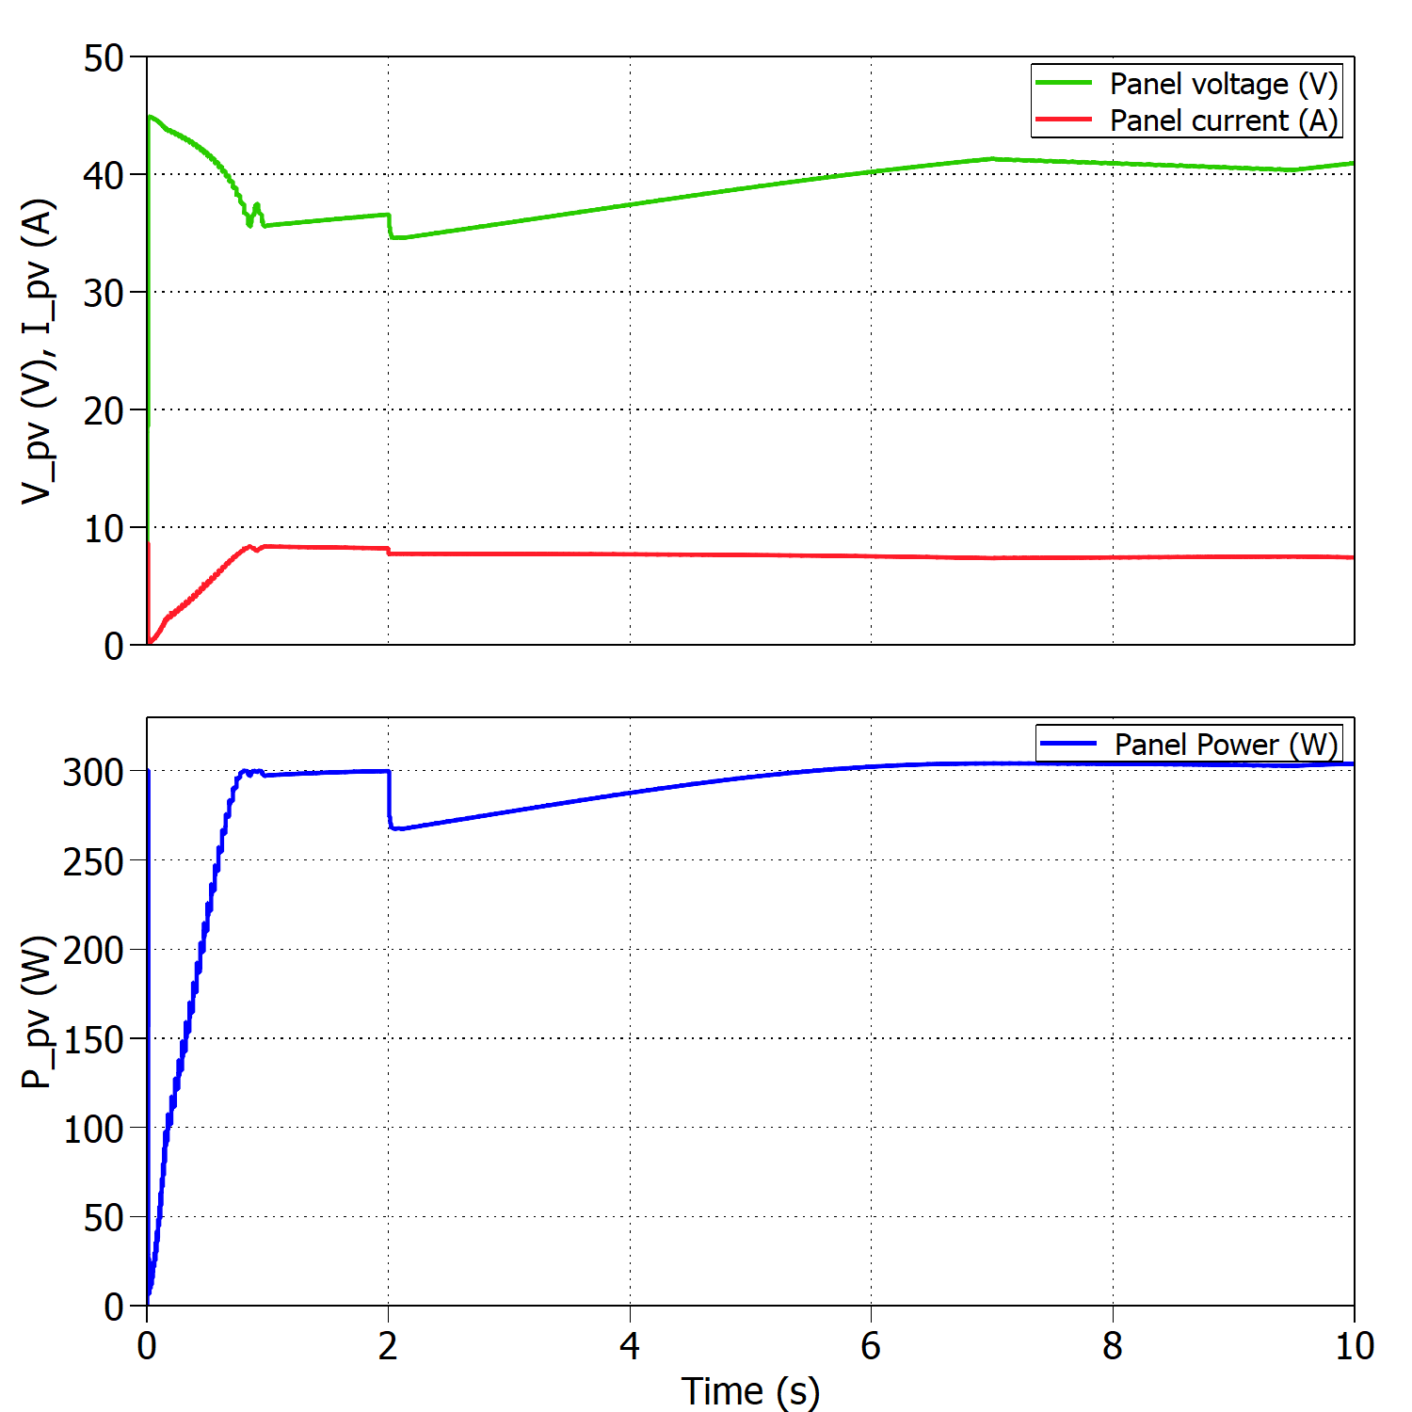
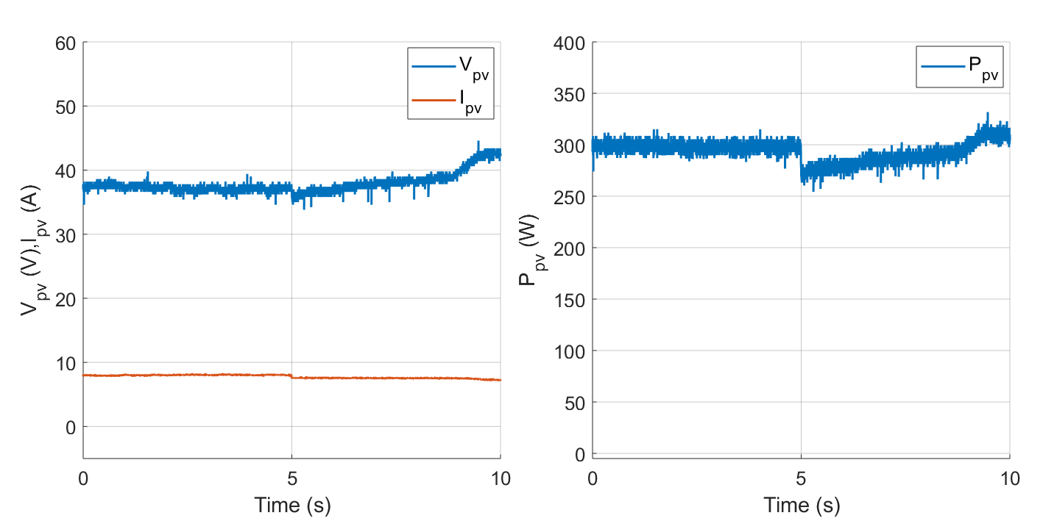


Sudden change in temperature
Buck mode ${(R}_{L}=3 Ω)$:
Experimental results for 25 - 15 ºC and constant irradiance 1000 W/m2.
$$η_{MPPTsim}=99.90\%$$
$$η_{MPPTexp}=98.40\%$$
Simulated results for 25 - 15 ºC and constant irradiance 1000 W/m2.

Slide 25
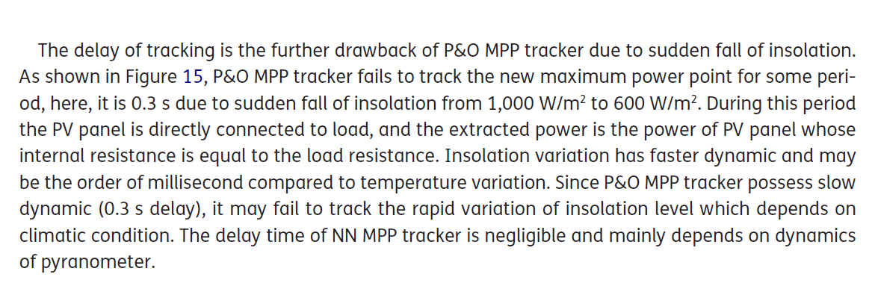
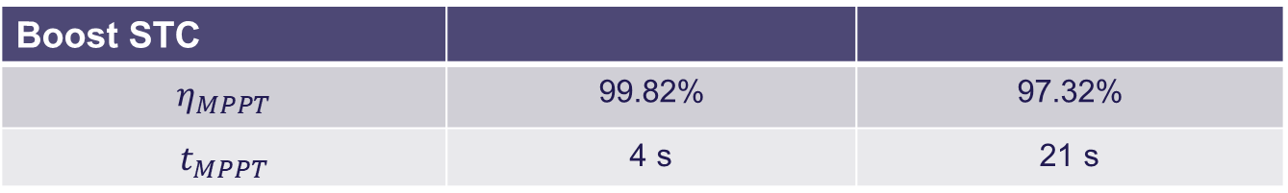
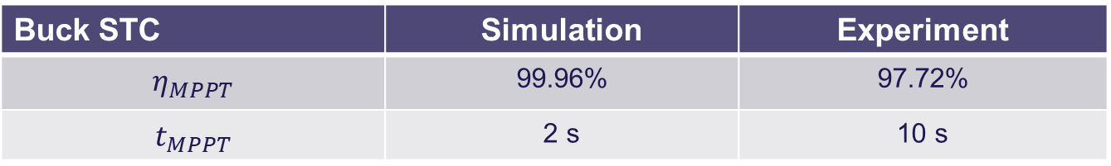
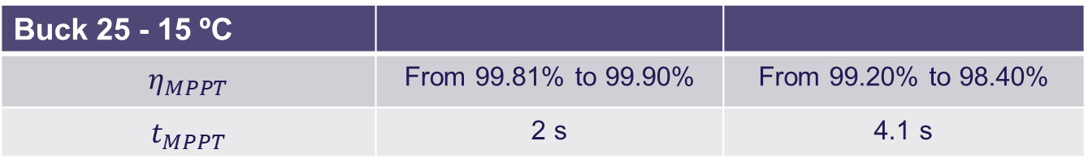

Comparison simulation and experiments
Buck STC | Simulation | Experiment
$$η_{MPPT}$$ | 99.96% | 97.72%
$$t_{MPPT}$$ | 2 s | 10 s
Boost STC
$$η_{MPPT}$$ | 99.82% | 97.32%
$$t_{MPPT}$$ | 4 s | 21 s
Buck 1000 - 800 W/m2
$$η_{MPPT}$$ | From 99.81% to 99.70% | From 95.96% to 93.78%
$$t_{MPPT}$$ | 0.5 s | 6.6 s
Buck 25 - 15 ºC
$$η_{MPPT}$$ | From 99.81% to 99.90% | From 99.20% to 98.40%
$$t_{MPPT}$$ | 2 s | 4.1 s

Slide 26
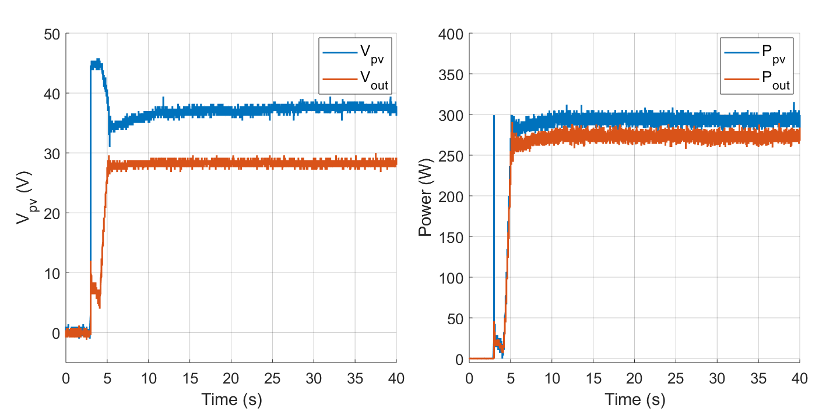

Efficiency of the converter
Buck mode:
Voltages and powers at the converter’s input and output under STC.
$$η_{converter}=\frac{P_{out}}{P_{PV}} ∗100=93.15\%$$

Slide 27
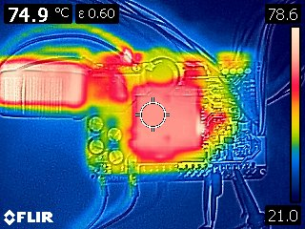
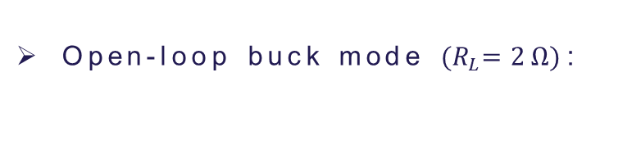
Thermal test
Open-loop buck mode ${(R}_{L}=2 Ω)$:
Coil and heat sink temperature varying with time .
Thermal camera showing hot and cold spots in the PCB.

Slide 28
Discussion

Slide 29
Converter design, change random picture

Slide 30

Thank you for your attention
Questions?

Slide 31
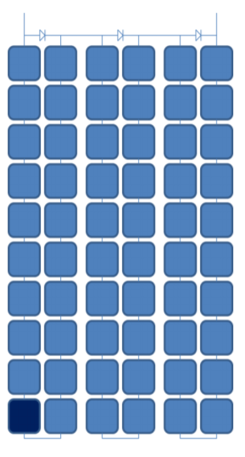
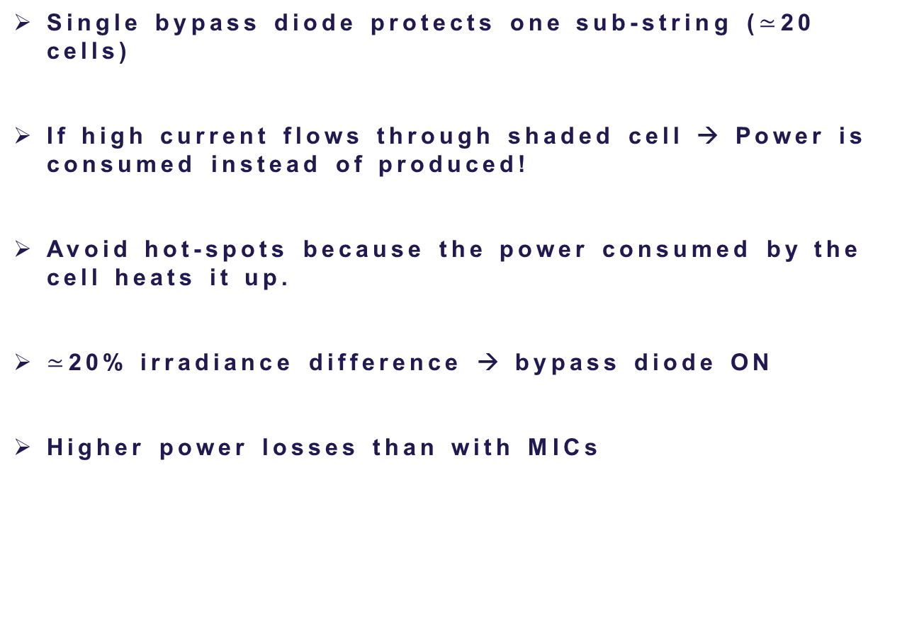
Bypass diodes vs MICs
Single bypass diode protects one sub-string ($≃$20 cells)
If high current flows through shaded cell → Power is consumed instead of produced!
Avoid hot-spots because the power consumed by the cell heats it up.
$≃$20% irradiance difference → bypass diode ON
Higher power losses than with MICs
Sub-string

Slide 32
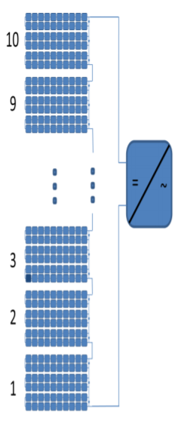
Bypass diodes vs MICs
Why using MICs improves power extraction?
Demonstration example: shaded cell at 80% irradiance
1st option: Bypass diode ON → 9*10% + 1*6.6% = 96.6%
2nd option: Reduce current to 80%→ 80% of full power
3rd option: MPPT tracker → 9*10% + 1*8% = 98%
Using MICs in each PV module → Increases power by 1.4%

Slide 33
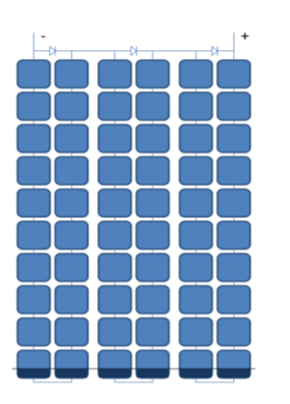
Bypass diodes vs MICs
Why using MICs improves power extraction?
Demonstration example: 30% shaded región
1st option: Bypass diodes ON → 9*10% + 1*0% = 90%
2nd option: Reduce current to 70%→ 70% of full power
3rd option: MPPT tracker → 9*10% + 1*7% = 97%
Using MICs in each PV module → Increases power by 7%

